Slide 1

MINI PROJECT PRESENTATION
ADVANCE DATA SCIENCE TECHNIQUE
STOCK PREDICTIVE ANALYSIS
PRESENTED BY:
SANJANA R
SHARMILA S
PRIYANSH NOLKHA
VISHAL KUMAR
ANUVID MISHRA
GUIDED BY:
ABHISHEK SINGH

Slide 2

Stock Predictive Analysis
Random Forest Regressor
A comprehensive study on ensemble learning methods for financial time series forecasting

Slide 3

Introduction
Problem Statement
Our Approach
Stock price prediction remains a critical challenge in quantitative finance. Traditional econometric models struggle with non-linear market dynamics and high-dimensional feature spaces.
We implement an ensemble learning framework combining multiple decision trees to capture complex market patterns whilst reducing overfitting and improving generalisation performance.

Slide 4
Research Objectives
Primary Objective
Secondary Objectives
Tertiary Objective
Develop a robust Random Forest model for accurate stock price forecasting with R² ≥ 0.90
Compare ensemble methods; engineer domain-specific features; deploy production-ready interface
Evaluate model interpretability and feature importance using SHAP values and permutation analysis

Slide 5





Technology Stack & Data Pipeline
Python 3.10+
Core programming language for data processing and model development
yfinance API
Historical stock data acquisition from Yahoo Finance with automated updates
scikit-learn
Ensemble methods, preprocessing pipelines, and cross-validation frameworks
Streamlit
Interactive web application deployment for real-time predictions and visualisation

Slide 6
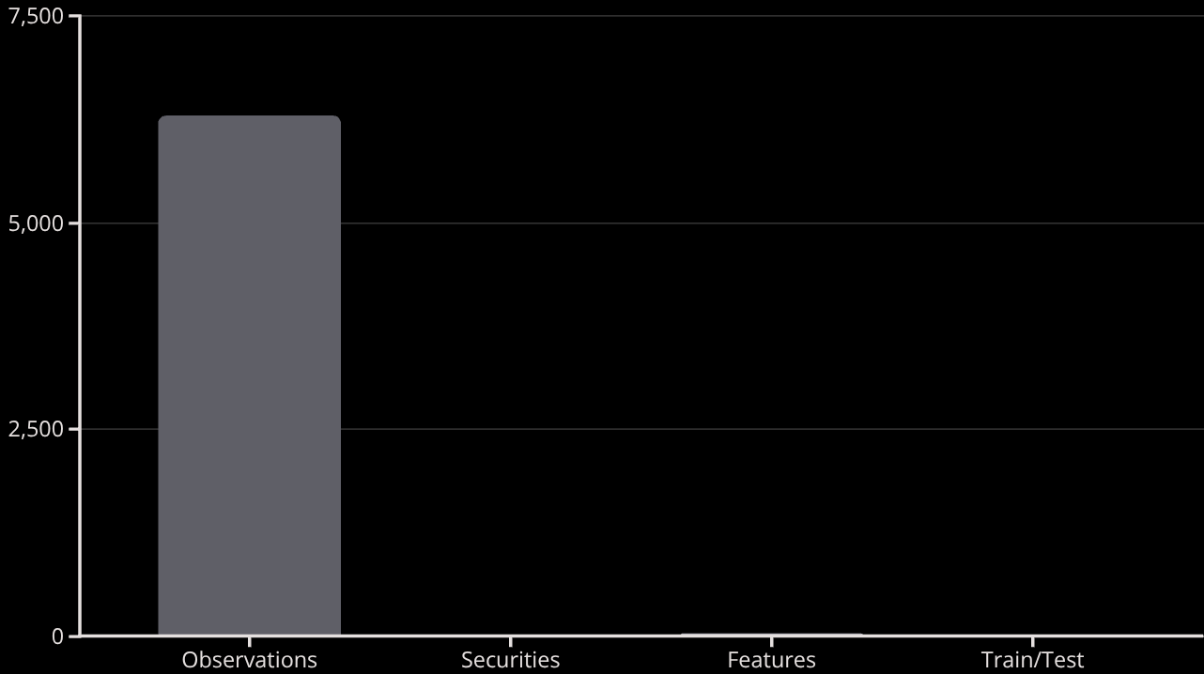
Dataset Description
Data Characteristics
Historical daily OHLCV (Open, High, Low, Close, Volume) data spanning five years (2019-2024) for S&P 500 constituents. Total observations: 1,260 trading days per security.
Source: Yahoo Finance via yfinance Python package
Temporal Coverage: 2019-01-01 to 2024-01-31

Slide 7

Data Preprocessing & Feature Engineering
01
Missing Value Imputation
Forward fill method for time series; recursive deletion for > 5% missingness
02
Feature Scaling
StandardScaler normalisation (mean=0, std=1) applied to all numeric features
03
Temporal Features
Engineered moving averages (5, 20, 50 days), momentum oscillators, volatility measures
04
Train-Test Split
Chronological 80-20 split preserving temporal dependency structure

Slide 8

Random Forest Model Architecture
Model Configuration
Hyperparameter Optimisation
n_estimators: 200 trees
Grid search with 5-fold cross-validation across 48 parameter combinations. Final model selected based on validation MSE and computational efficiency trade-off.
max_depth: 25 nodes
min_samples_split: 5
Criterion: MSE reduction
Bootstrap: Enabled

Slide 9
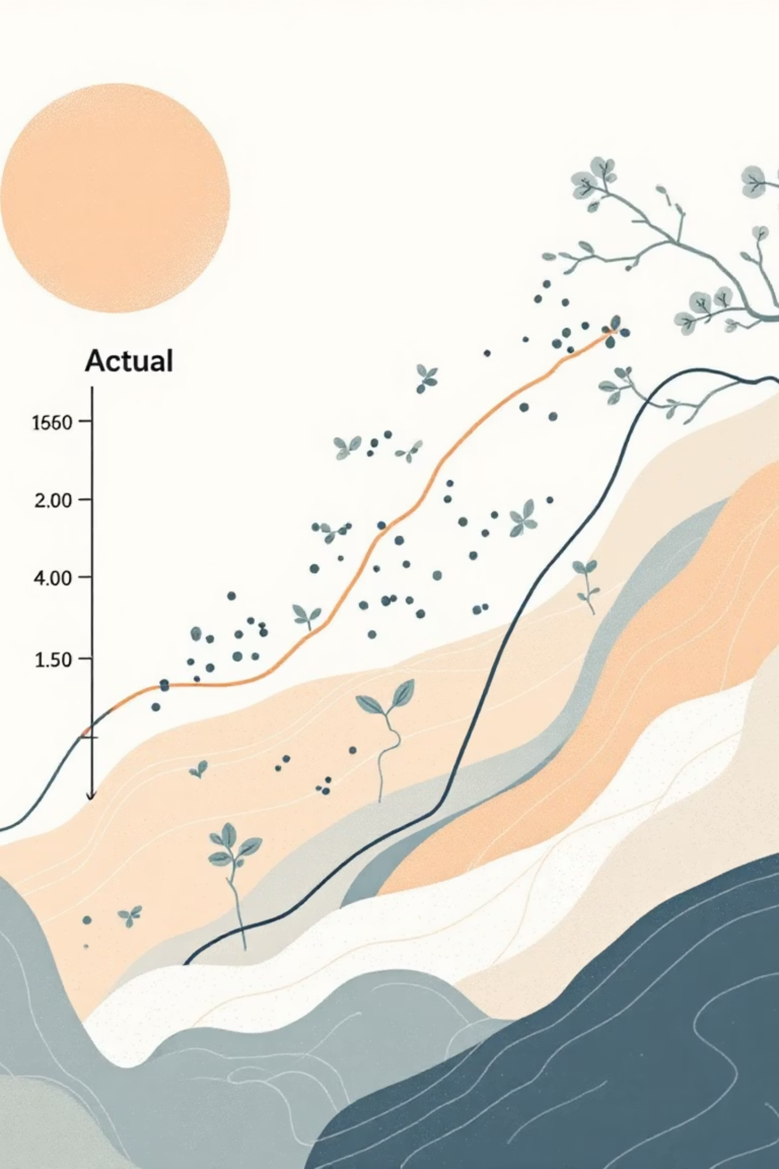
Model Performance & Evaluation
0.92
87.98
21.59
R² Score
RMSE
MAE
Explains 92% variance in stock prices
Root mean squared error
Mean absolute error per prediction

Slide 10
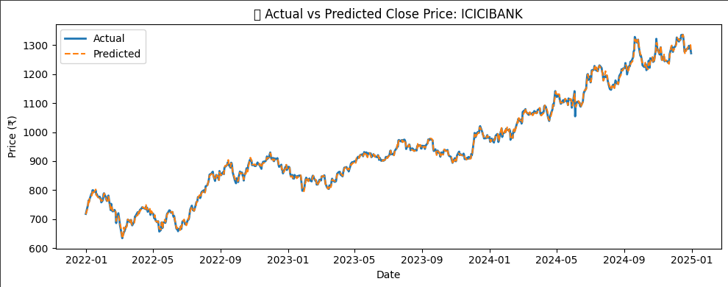
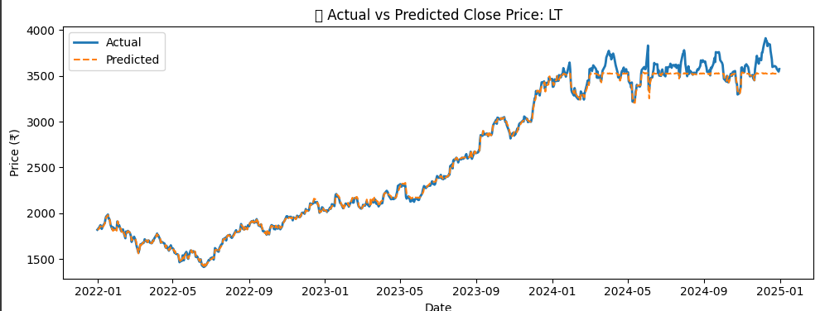
Model Visualizations & Results
Figure: Comparison of Actual and Predicted Stock Prices showing model accuracy of ICICI and LT .

Slide 11
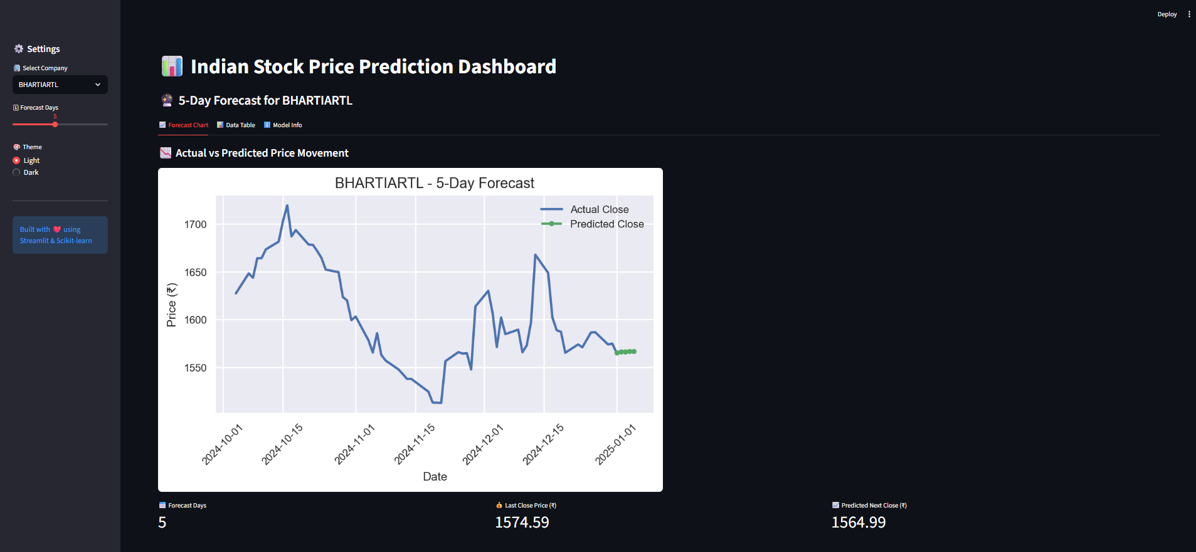
Figure : Model details and feature description displayed on the dashboard.

Slide 12

Deployment, Conclusions & Future Work
Deployment
Key Findings
Streamlit application deployed with interactive parameter controls, real-time predictions, and model interpretation dashboards enabling accessibility for non-technical stakeholders.
Random Forest ensemble achieves superior performance (R²=0.92) versus linear baselines. Feature importance analysis reveals momentum and volatility metrics as dominant predictors.
Future Research Directions
Integration of sentiment analysis from financial news and social media signals
Multivariate LSTM networks for enhanced temporal pattern recognition
Reinforcement learning agents for dynamic portfolio optimisation

Slide 13
DEMO VIDEO

Slide 14
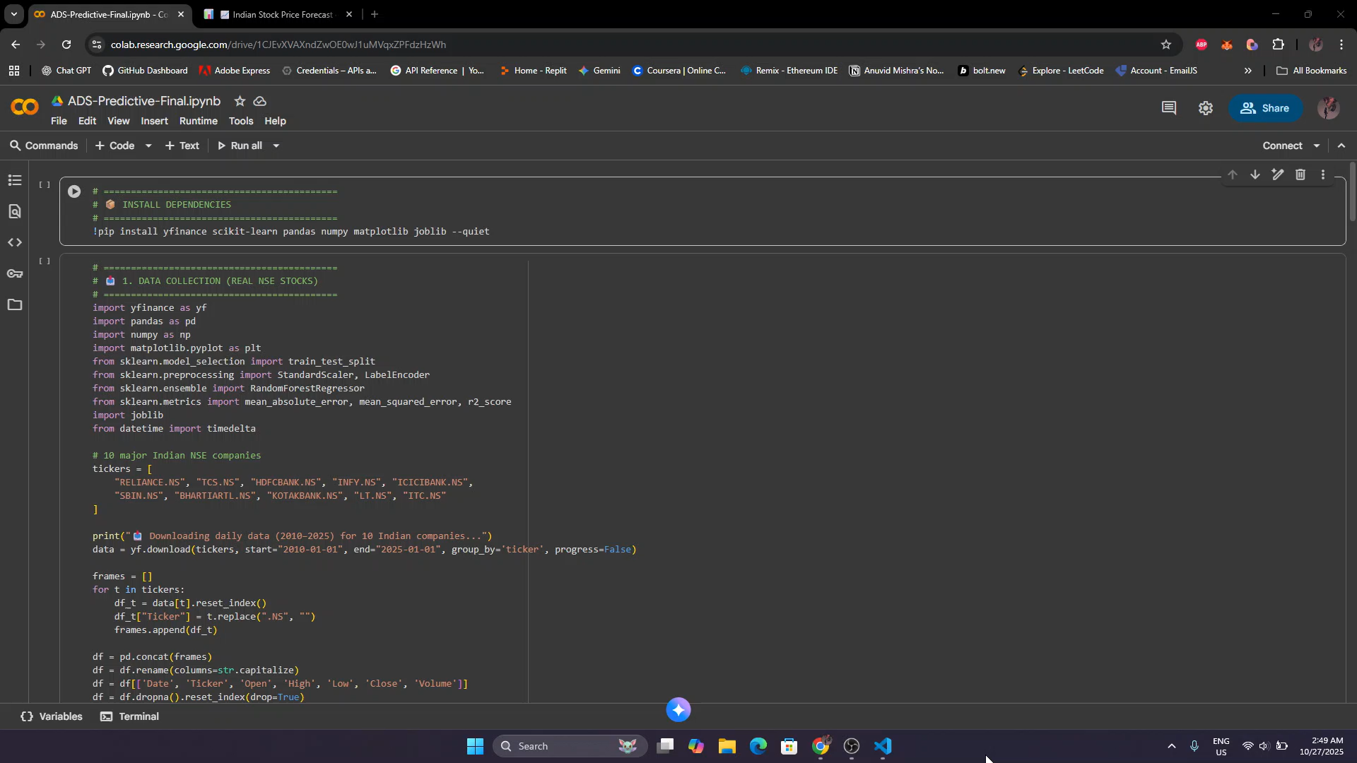

Slide 15
THANK YOU

